Slide 1

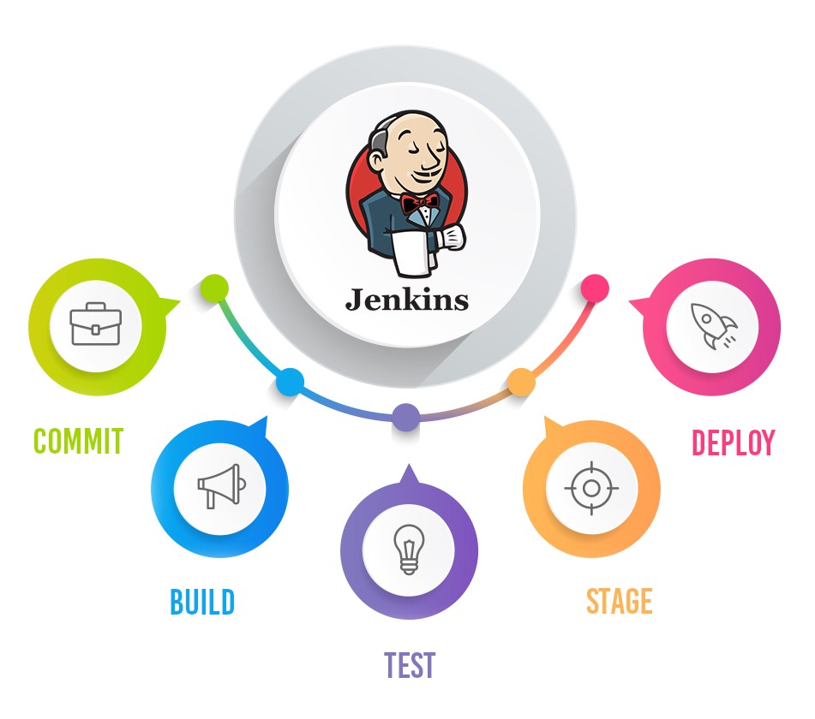
Software Testing QnA
Pramod Dutta
Your Questions in TheTestingAcademy

